Slide 1

INSTRUCTIONS
for this presentation
This template can be used for workshops, meetings with your co-creation arena and other stakeholders. It can help to explain the CCC project. While the slides include the most important message, additional info and talking points can be found in some of the slides' notes sections.
The template aims to be versatile and flexible, allowing you to choose the slides you need for your purpose. It is in English, but you are welcome to translate it in your own language.
!!! Please download a copy of this presentation for your purposes and do not edit the original.
The template can be edited and adjusted over time, especially if we want to add more slides. If you think something is missing, please use the MS TEAMS Comms deliverables and intl. Dialogue channel to communicate your needs.
Notes:
1

Slide 2



Roles and responsibilities
of CCSI and CE stakeholders
Place | Date
Speaker
https://interreg-baltic.eu/project/ccc/

Slide 3


Photo: Aarhus / DCI
Involving creative and cultural actors into the transition from a linear to a circular economy requires the efforts of diverse stakeholders.
Notes:
The local transition to circular economy is a common need across the entire Baltic Sea region, and the involvement of creative and cultural actors is a common opportunity that is not more widely and strategically utilized so far.
Joining forces and tackling the issue through cooperation of a variety of stakeholders can enable a successful and wide reaching impact of circular solutions that are developed with the involvement of creative actors.
So who needs to be involved in creating an environment in which creatives can support the circular transition?
3

Slide 4





Key stakeholders
Business Support Organisations
Non-Governmental Organisations
Municipalities
Regional Network Organisations
Public
Authorities
Notes:
Who are the organisations that can help bridge the gap between creative and cultural actors and the circular economy?
4

Slide 5
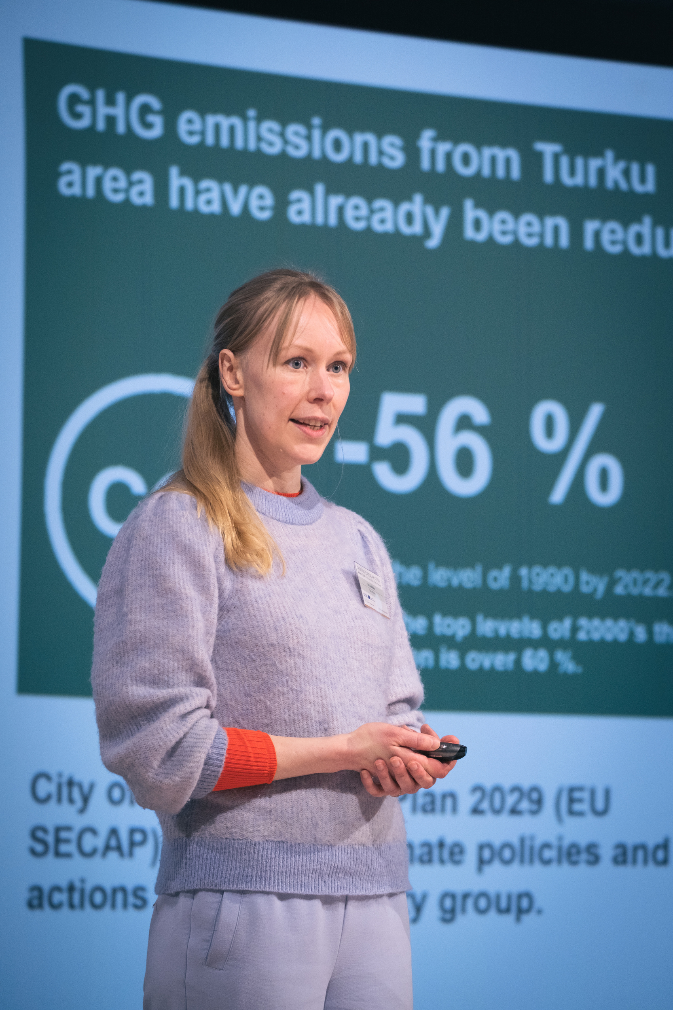
Why
municipalities?
Municipalities are key actors in the transition towards a circular economy, as they:
  set local policy goals and guidelines on both production and consumption on behalf of the citizens,
  possess the resources, such as incubators and cultural centers, to actively support circular economy initiatives,
  serve as a bridge between civil society and local action.
Importantly, municipalities can strategically involve creative and cultural actors to help bringing such initiatives to life.
Photo: Turku / Hannu Aaltonen
Notes:
5

Slide 6
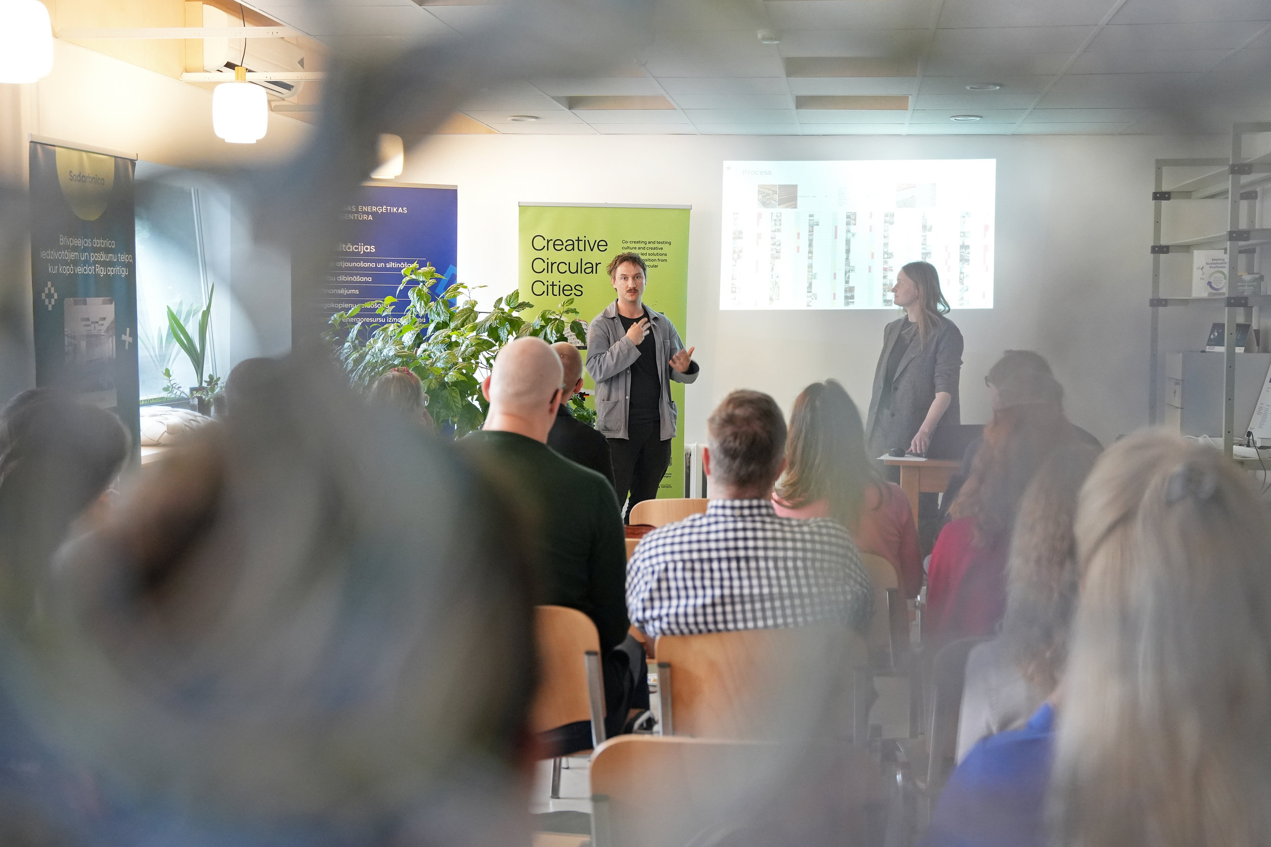
Why
Business Support Organisations (BSO)?
BSOs can help drive circular transitions led by the cultural and creative sectors (CCSI) at the local level, as they:
  implement programmes / initiatives that help creative and cultural entrepreneurs develop circular business models,
  can work directly with creatives as beneficiaries of support or participants in these programmes,
  can leverage the expertise by involving these actors in advisory roles to help designing more holistic and effective support measures.
Photo: Riga / DCI
Notes:
5

Slide 7
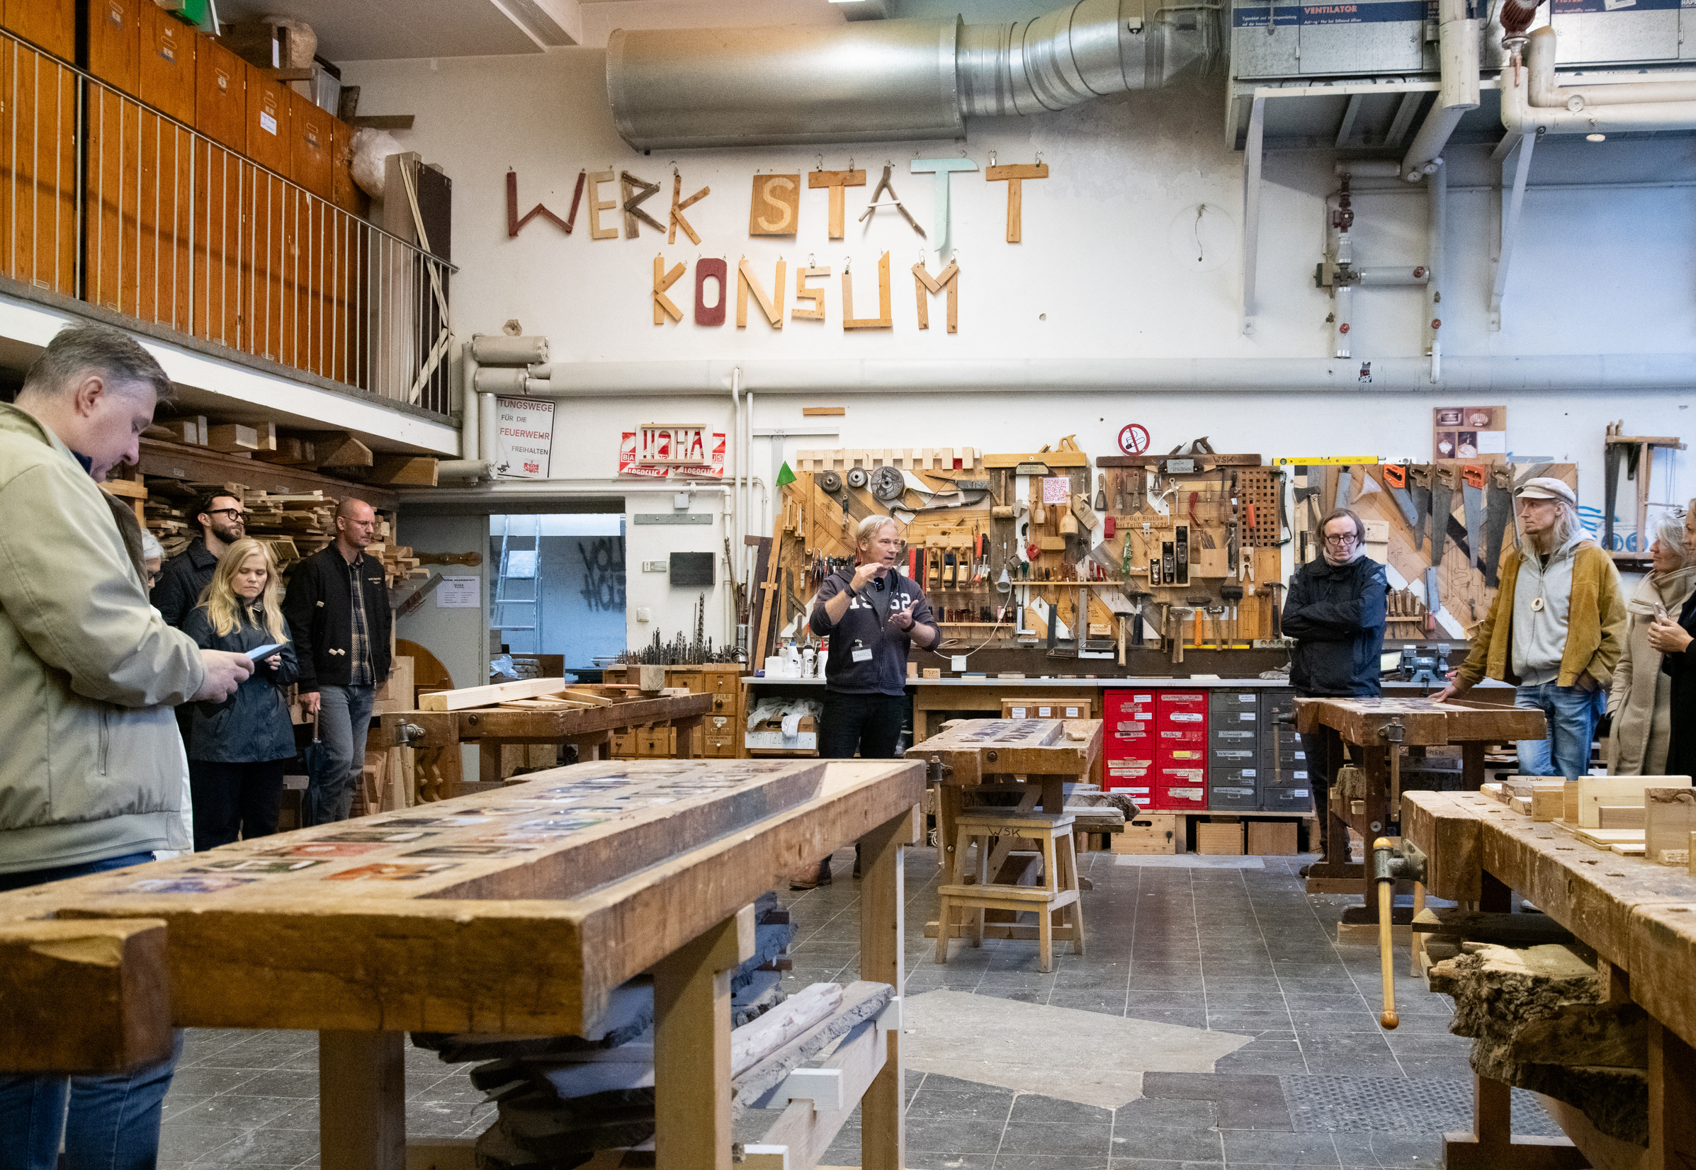
Why
Non-Governmental Organisations (NGO)?
Local NGOs and community initiatives focused on the cultural and creative sectors (CCSI) and the circular economy are important enablers of circular transitions at the local level.
By collaborating with creative professionals on projects that promote circular lifestyles, they can develop innovative and engaging ways to educate the public and inspire sustainable behavior change among citizens.
Photo: Kiel / Jan Konitzki
Notes:
5

Slide 8

Why
Network
Organisations?
Various regional, national and transnational network organisations can support initiatives that include creative and cultural actors in circular economy initiatives. They can provide guidance and advice to relevant local stakeholders, help make necessary connections amongst parties and do political lobbying.
By doing this, they can maximise the reach and impact of CCSI-led local circular economy initiatives.
Photo: Kiel / Jan Konitzki
Notes:
5

Slide 9
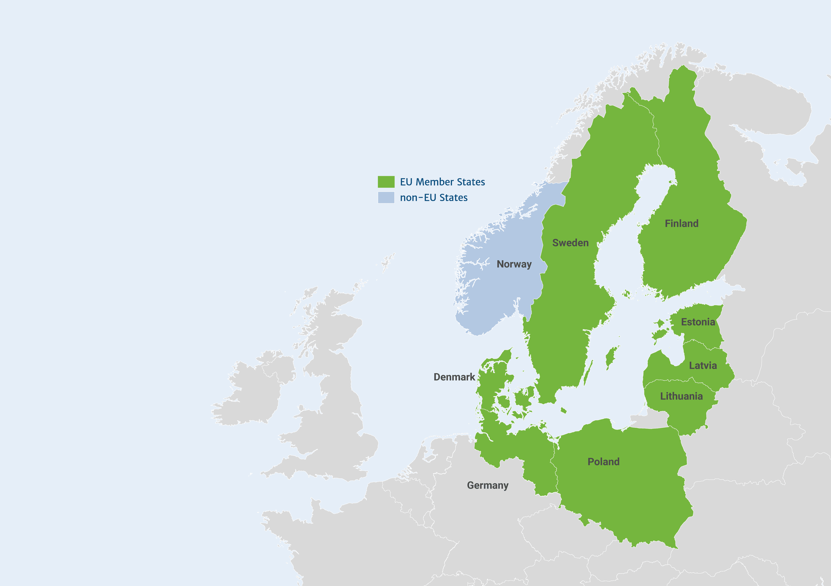

Why national
public authorities?
National ministries and agencies are important enablers and supporters for CCSI-driven circular transition at local level.
They can stipulate local actions with legislation and regulations, supporting their implementation with funding schemes or change legal and regulatory frameworks that hinder the transition to a circular economy.
Notes:
5

