Slide 1

INSTRUCTIONS
for this presentation
This template can be used for workshops, meetings with your co-creation arena and other stakeholders. It can help to explain the CCC project. While the slides include the most important message, additional info and talking points can be found in some of the slides' notes sections.
The template aims to be versatile and flexible, allowing you to choose the slides you need for your purpose. It is in English, but you are welcome to translate it in your own language.
!!! Please download a copy of this presentation for your purposes and do not edit the original.
The template can be edited and ajusted over time, especially if we want to add more slides. If you think something is missing, please use the MS TEAMS Comms deliverables and intl. Dialogue channel to communicate your needs.
Notes:
1

Slide 2



Creative and cultural actors
and the circular economy
Place | Date
Speaker
https://interreg-baltic.eu/project/ccc/

Slide 3










Linear Economy
Raw
materials
Design
Production
Distribution
Consumption
Waste
Landfill
Notes:
In order to talk about the circular economy you need to mention the linear economy first.
In a linear economy, raw materials are being used to turn an idea into a product, which is then being distributed to retailers, bought and used by the consumer and in the end, discarded. In a best case scenario, the item might be recycled, but if not, it will end up in landfill.
In a linear economy, little to no consideration goes into the durability of the product, its impact on nature, or its ability to be reused or recycled.
3

Slide 4



Circular
Economy
Raw
materials
Design
Production
Residual
waste
Recycling
Distribution
Collection
Re-use,
repair,..
Notes:
In a circular economy you can still find some of the stages and elements included in a linear economy, however, the circular economy approach encourages us to be more mindful and intentional about production and consumption of products. The emphasis lies on
- extending lifecycles of products and / or materials (so keeping products in use for as long as possible)
- minimising waste and pollution
- regenerating nature.
4

Slide 5
Circular economy
in numbers
11,5%
513 kg
2020
The EU’s circularity
of material use rate
in 2022
Amount of municipal waste produced by
an EU citizen
in 2022
The year the EU adopted the Circular Economy Action Plan
Source: European Commission
Notes:
Please feel free to change, depending on the necessary emphasis!
Sources:
11.5 – Eurostat - https://ec.europa.eu/eurostat/statistics-explained/index.php?title=Circular_economy_-_material_flows
513: Eurostat - https://ec.europa.eu/eurostat/web/products-eurostat-news/w/ddn-20240208-2
2020: European Commission - https://environment.ec.europa.eu/strategy/circular-economy-action-plan_en
5

Slide 6
Creative and cultural
sectors and industries (CCSI)
in numbers
444 mln
7.7 mln
3,8%
Turnover in euros generated by CCSIs
in the EU-28 in 2020
People in cultural employment across
the EU in 2022
Percentage of cultural sector employees of total EU employment
in 2022
Source: European Commission
Notes:
Please feel free to change, depending on the necessary emphasis!
Sources:
11.5 – Eurostat - https://ec.europa.eu/eurostat/statistics-explained/index.php?title=Circular_economy_-_material_flows
513: Eurostat - https://ec.europa.eu/eurostat/web/products-eurostat-news/w/ddn-20240208-2
2020: European Commission - https://environment.ec.europa.eu/strategy/circular-economy-action-plan_en
5

Slide 7

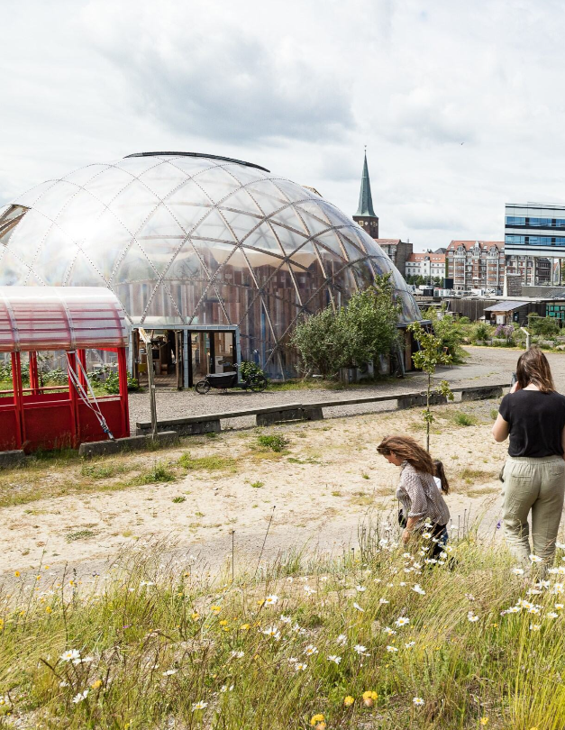
Why creatives and circular economy?
Creatives can be drivers for circular economy in the Baltic Sea region. They are a social force with great influence on mindsets of people and can help to promote “circular lifestyles”.
At the same time, they are a business field with a considerable GDP share and a high innovation potential that can support circular business models.
Photo: Aarhus / DCI
Notes:
Additional information:
Local circular transition is widely acknowledged as the key first step towards a comprehensive circular economy, as it allows a “system change” that integrates the production and consumption side at manageable scale. In particular, the “dual role” of CCSI as facilitator of circular consumption and frontrunner for circular production may be utilised.
7

Slide 8
The role of creative and cultural actors in accelerating local circular transitions
User
Enabler
Multiplicator
Notes:
1. User
CCSI creates products and services that comply with the principles of the circular economy and converts traditional business models to circular models.
—> e.g. festivals such as Waterkant Festival goes Zero Waste; or Cradle to Cradle printing companies
2. Enabler
CCSI enables other industries to apply circular economy principles The design industry plays a particularly important role here.
—> Innovation, re-design of processes, re-design of products and services, design, architects
3.Multiplicator
Many submarkets (including the games, press, advertising, film and book markets) have a multiplier and mediator function and ensure that the circular economy is also more widely used in other areas.
—> Storytelling, visualization, communication, culture, example setting
8

Slide 9
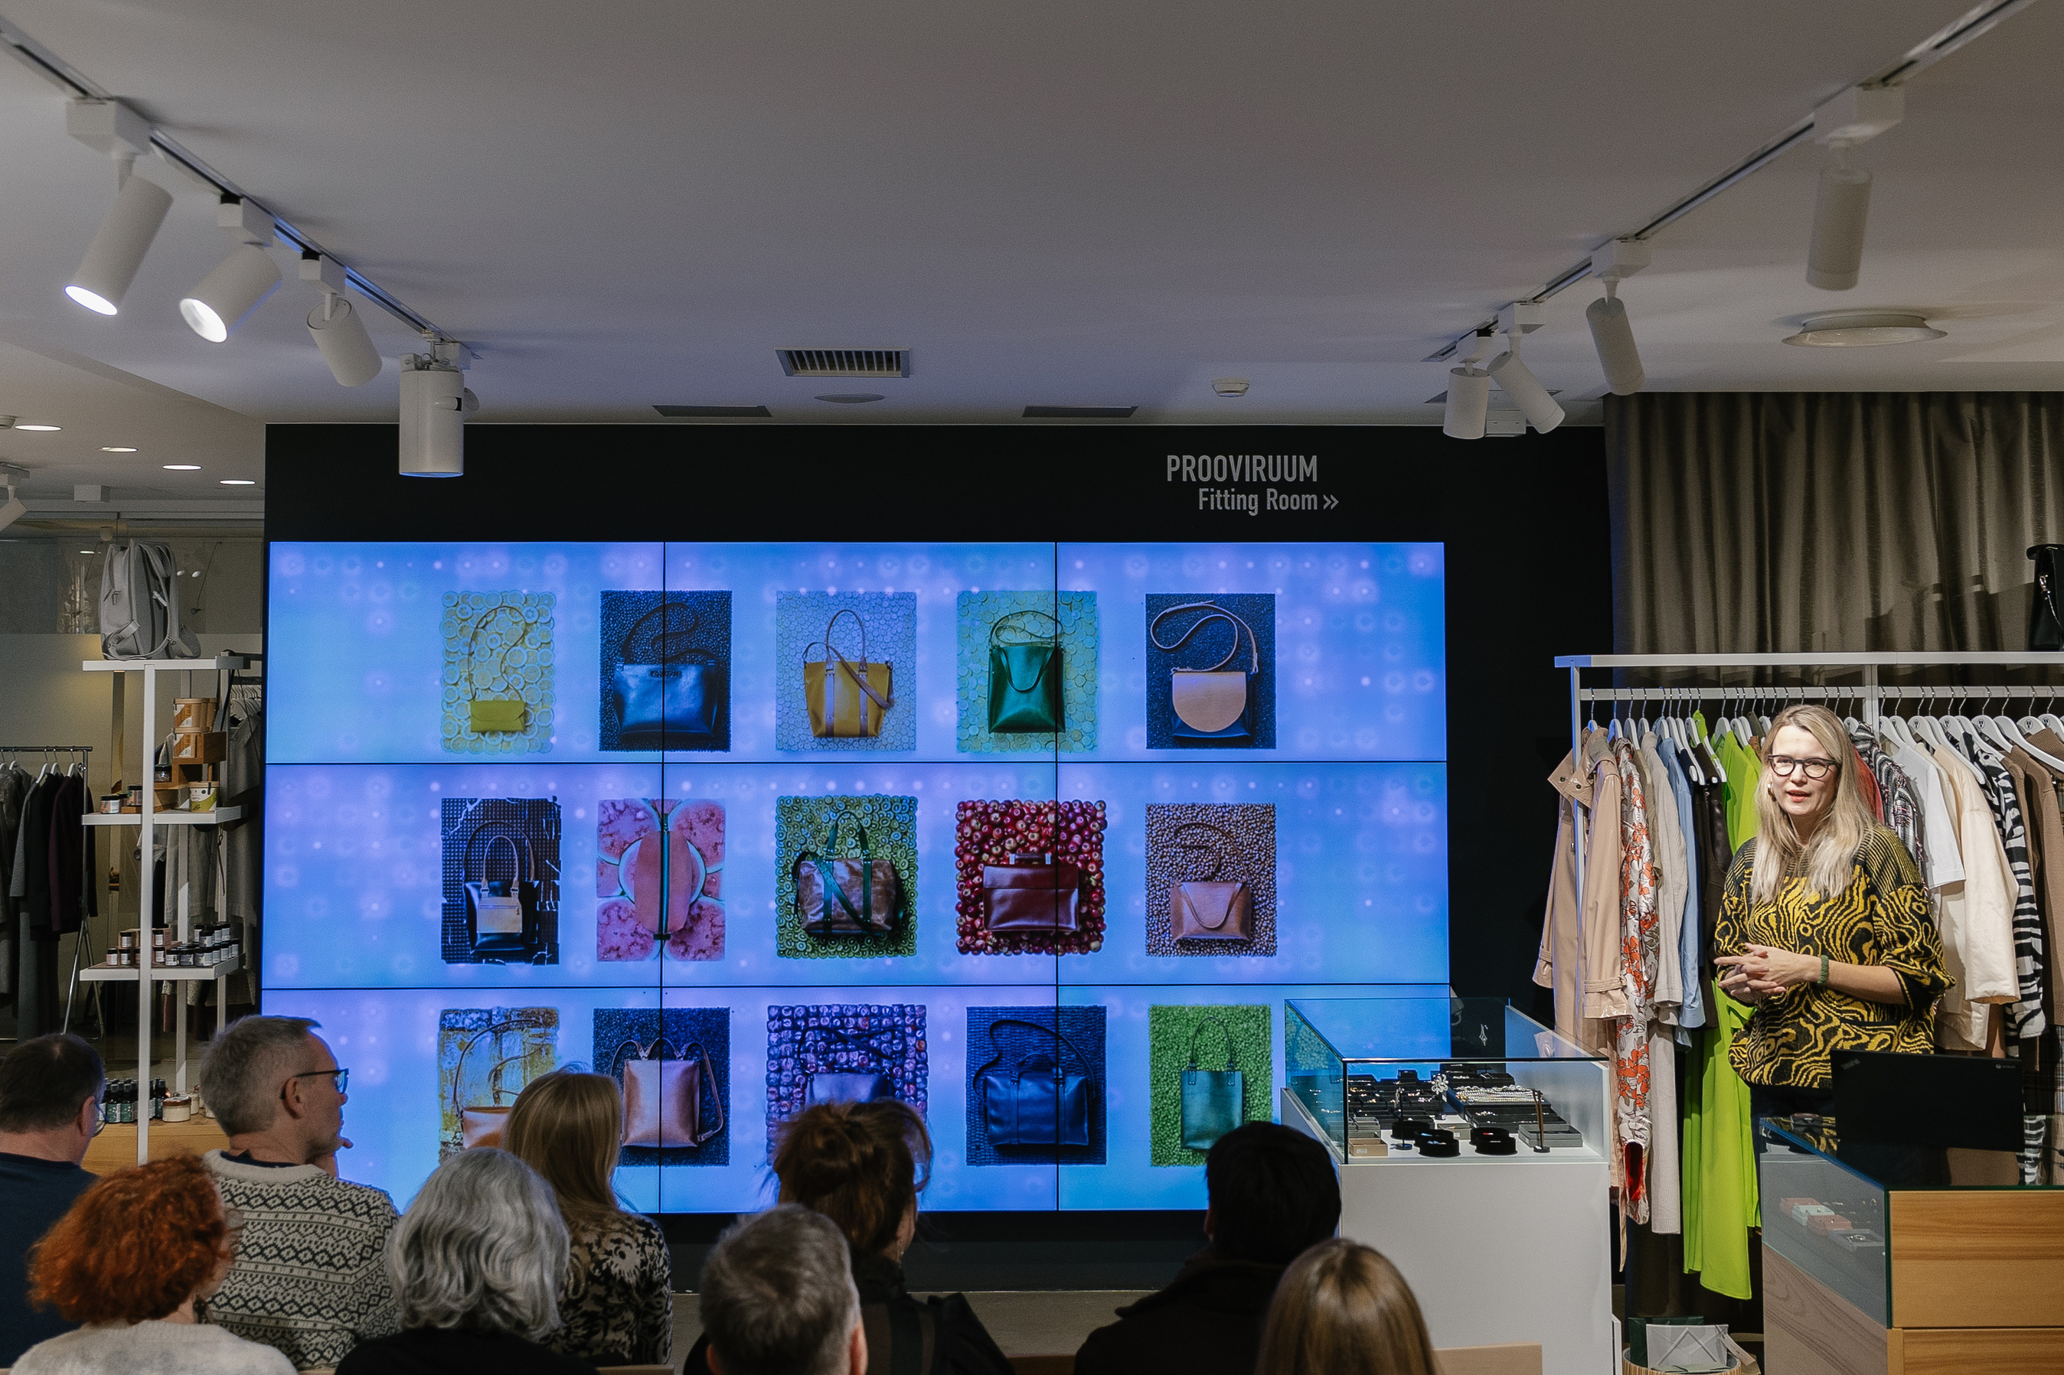
The role of CCSI
in a circular economy (production)
With expertise in design, architecture, textiles, and more, creatives can help embed circularity into a wide range of products, supporting the extension of their lifecycle and ensuring sustainability from manufacturing through to disposal
Photo: Tallinn / DCI
Notes:
Some key considerations:
Raw material: what is the source material, and how can we extract it sustainably? Do we need to source new raw materials at all? Can we reuse instead?
Product specifications: is the product reusable, repairable and recyclable?
Manufacturing process: is it energy-efficient, and does it generate any waste? Is packaging really needed?
Distribution and use: How much energy does it take to deliver and use the product/service? Where does this energy come from?
Disposal: Can the product be dismantled? Can we use the parts as-is in the manufacturing process again? Can we return the raw materials to the earth?
9

Slide 10
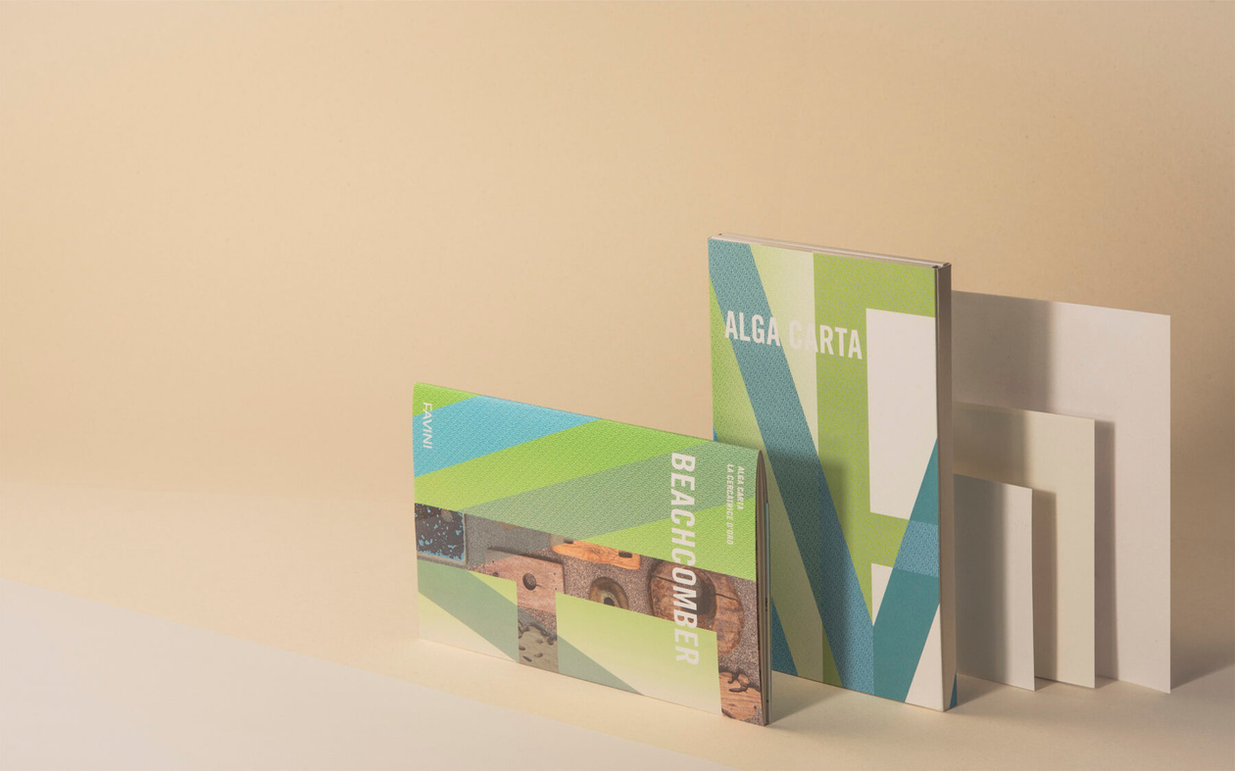

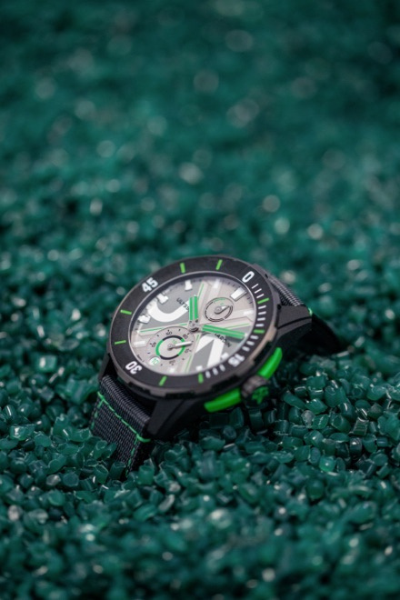
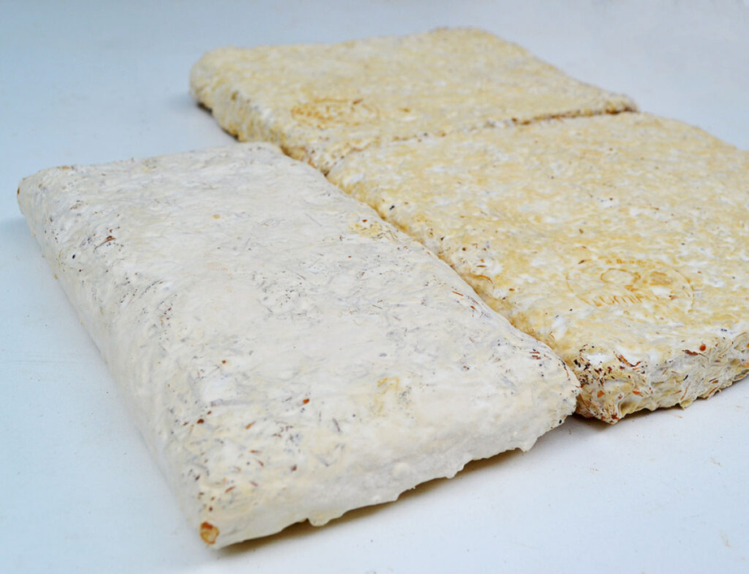
Examples
Turns overabundant
seaweed into paper
ALGA CARTA (IT)
Transforms fishing nets into materials, e.g. used in watches
FIL & FAB (FR)
FAIRPHONE (NL)
A modular smartphone
designed for easy repair
PERMAFUNGI (BE)
Produces insulating panels made from mushroom
Notes:
Customize examples as you wish, but here are some suggestions:
Headphones: headphone subscription service with free repairs and easily replaceable parts. Once no longer needed, they are returned, and either re-used or dismantled in a safe and sustainble way to minimize eletronic waste. More info: https://repeat.audio/en/
Mobile phone: Modular and repairable design. More info: https://www.fairphone.com/
Hat: made of deadstock materials. More info: https://joanieclothing.com/the-edit/deadstock.html
Building: Example from Switzerland. The building reuses an existing warehouse, inclusive of a new 3-storey superelevation. The newly designed portions incorporate salvaged construction and demolition waste, and recycled building materials. More info: https://www.archdaily.com/968958/k118-kopfbau-halle-118-hauburo-in-situ
10

Slide 11
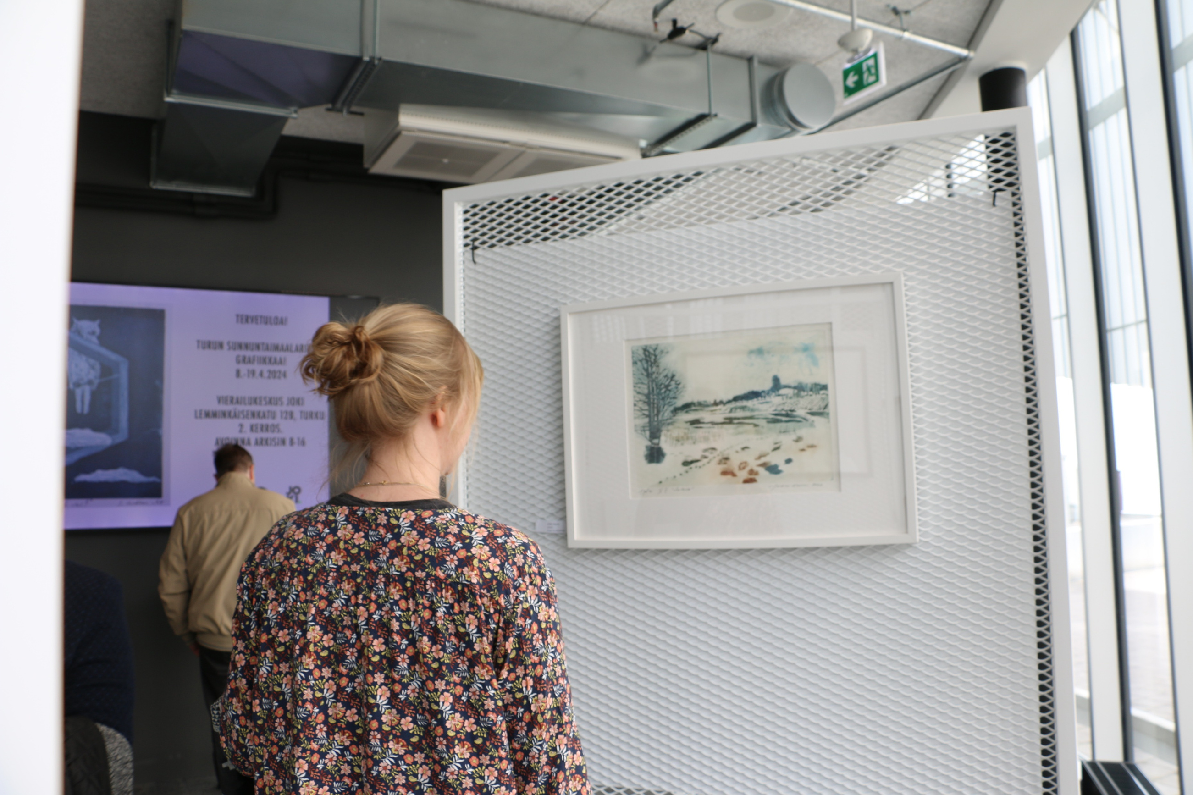
The role of CCSI
in a circular economy (consumption)
The arts play a unique role in shaping public opinion and influencing behavior. From music and film to fashion and design, the creative industries have the power to shape cultural values and attitudes toward the environment.
Art exhibitions, performances, festivals, and other creative works can serve as powerful platforms for communicating important messages about the environment and consumerism
Photo: Kiel / DCI
Notes:
Creative and cultural actors can play an important part in supporting the consumption side of the circular economy.
By promoting circular practices and rethinking waste, creatives can help raise awareness and educate the public about the importance of circularity.
11

Slide 12
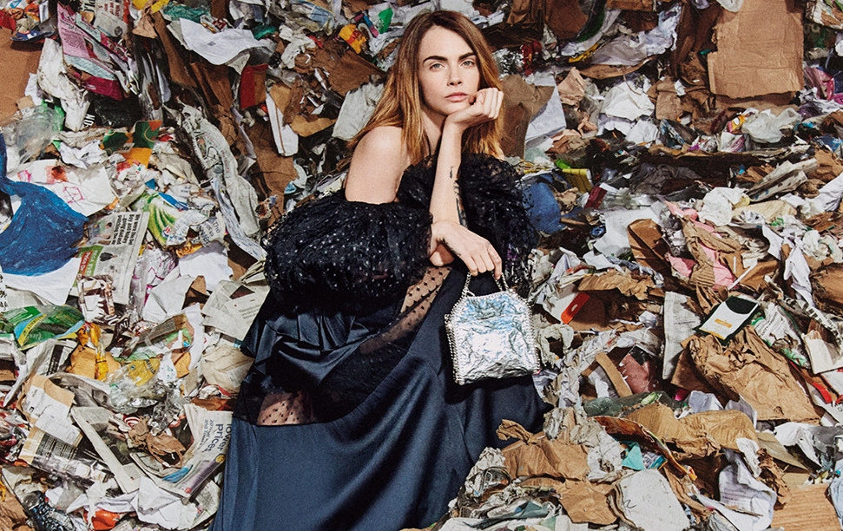
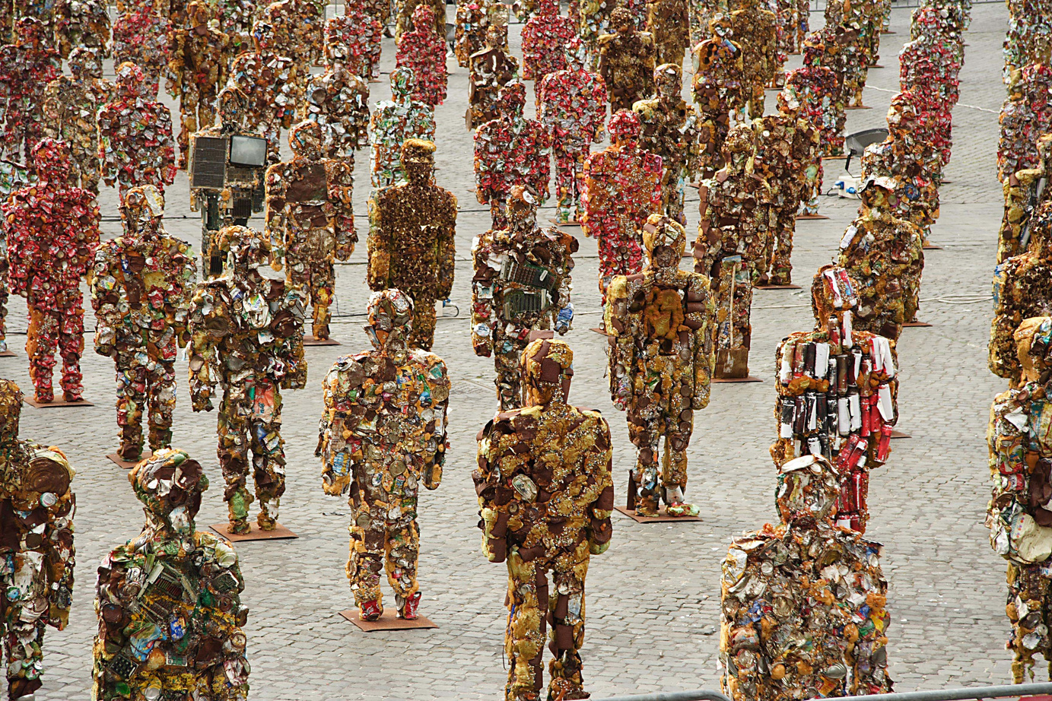

Examples
HA SCHULT - TRASH PEOPLE (DE)
Life-sized figures made from recycled materials toured globally to spark discussion on waste and consumption
STELLA MCCARTNEY (UK)
Her campaign turned a London recycling plant into a runway, showcasing a collection made from circular materials
EUROPEAN CIRCULAR
ONLINE MUSEUM (EU)
Digital platform fostering a European community of upcycling artists and designers
Notes:
Customize examples as you wish, but here are some suggestions:
Headphones: headphone subscription service with free repairs and easily replaceable parts. Once no longer needed, they are returned, and either re-used or dismantled in a safe and sustainble way to minimize eletronic waste. More info: https://repeat.audio/en/
Mobile phone: Modular and repairable design. More info: https://www.fairphone.com/
Hat: made of deadstock materials. More info: https://joanieclothing.com/the-edit/deadstock.html
Building: Example from Switzerland. The building reuses an existing warehouse, inclusive of a new 3-storey superelevation. The newly designed portions incorporate salvaged construction and demolition waste, and recycled building materials. More info: https://www.archdaily.com/968958/k118-kopfbau-halle-118-hauburo-in-situ
10

