Slide 1

INSTRUCTIONS
for this presentation
This template can be used for workshops, meetings with your co-creation arena and other stakeholders. It can help to explain the CCC project. While the slides include the most important message, additional info and talking points can be found in some of the slides' notes sections.
The template aims to be versatile and flexible, allowing you to choose the slides you need for your purpose. It is in English, but you are welcome to translate it in your own language.
The information in slide 12 is similar to what is included in slides 13-16. The presenter can choose which slide or set of slides to use.
!!! Please download a copy of this presentation for your purposes and do not edit the original.
The template can be edited and ajusted over time, especially if we want to add more slides. If you think something is missing, please use the MS TEAMS Comms deliverables and intl. Dialogue channel to communicate your needs.
Notes:
1

Slide 2



Interreg BSR project
«Creative Circular Cities»
Place | Date
Speaker
https://interreg-baltic.eu/project/ccc/

Slide 3
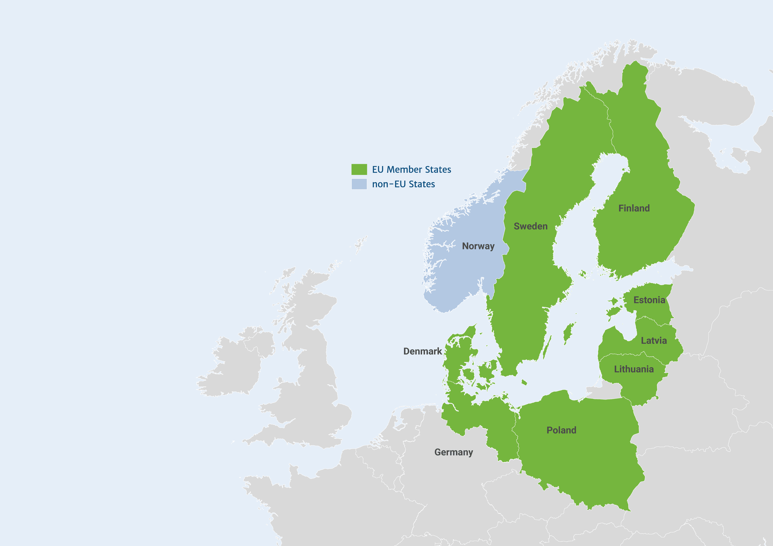

Creative Circular Cities (CCC)
CCC brings together
14 partners from six Baltic Sea Region cities to showcase how culture and creativity
can play a key role in driving
a circular economy
Notes:
The Interreg Creative Circular Cities project brings together 14 project partners from six cities around the Baltic Sea.
6

Slide 4






Creative Circular Cities
Notes:
The Interreg Creative Circular Cities project brings together 14 project partners from six cities around the Baltic Sea.
7

Slide 5


Interreg
Baltic Sea Region 2021 - 2027
The Interreg BSR programme is a source of
EU funding that brings together cultures, perspectives and expertise to get the best ideas and joint solutions.
With the support of Interreg BSR, projects drive the transition to a green and resilient region.
Notes:
Interreg Baltic Sea Region (BSR) covers nine countries, eight of them EU Member States (Denmark, Estonia, Finland, Germany, Latvia, Lithuania, Poland and Sweden) and one third country (Norway).
8

Slide 6



CCC project partners
Business support
organisations
Non-governmental
organisations
Municipalities
Notes:
The Interreg Creative Circular Cities project brings together 14 project partners from six cities around the Baltic Sea.
The project partners can be categorized into the following types.
9

Slide 7















CCC project partners
Notes:
The Interreg Creative Circular Cities project brings together 14 project partners from six cities around the Baltic Sea.
10

Slide 8
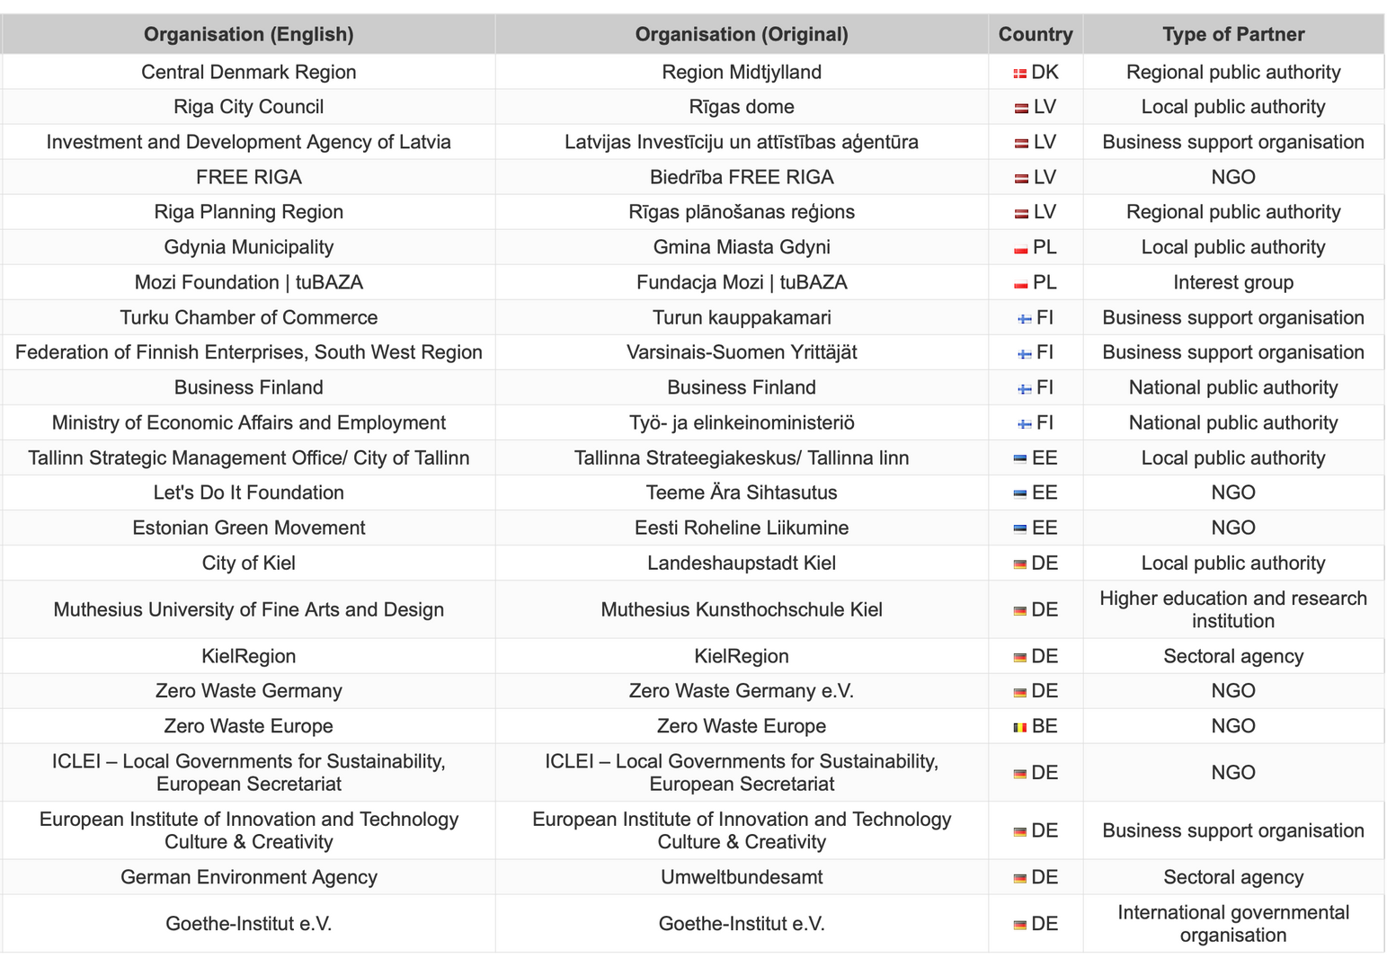
CCC associated organisations
Notes:
The Interreg Creative Circular Cities project brings together 23 associated organisations.
11

Slide 9
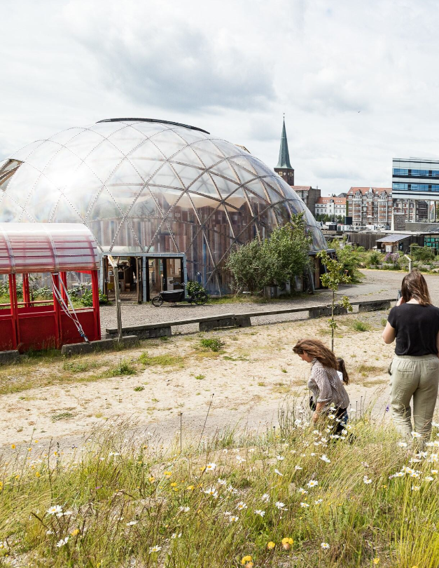
Why creatives and circular economy?
Creatives can be drivers for circular economy in the Baltic Sea region. They are a social force with great influence on mindsets of people and can help to promote “circular lifestyles”.
At the same time, they are a business field with a considerable GDP share and a high innovation potential that can support circular business models.
Photo: Aarhus/ DCI
Notes:
Additional information:
Local circular transition is widely acknowledged as the key first step towards a comprehensive circular economy, as it allows a “system change” that integrates the production and consumption side at manageable scale. In particular, the “dual role” of CCSI as facilitator of circular consumption and frontrunner for circular production may be utilised.
12

Slide 10





Current challenges
Lack of Communication
Business Challenges
Limited Involvement
Strategic Planning
Government Support
Notes:
Additional information:
Unfortunately there are several challenges that impede the integration of creative and cultural actors into cities’ circular economy activities.
Lack of Communication: There's not enough sharing of knowledge and ideas between local governments and CCSI folks, so opportunities to promote circular economy at the local level are missed.
Business Challenges: CCSI businesses need more support, like know-how, networks, and money, to develop circular models. Programs to help with this are rare.
Limited Involvement: CCSI aren't consistently involved in promoting circular economy, even though they have proven tools to engage people and change behavior.
Strategic Planning: Cities in the BSR often have strategies for circular economy or boosting CCSI, but they rarely combine the two strategically.
Government Support: National governments aren't doing enough to support circular economy locally or involve CCSI. They lack awareness, clear rules, and financial help for these efforts
13

Slide 11
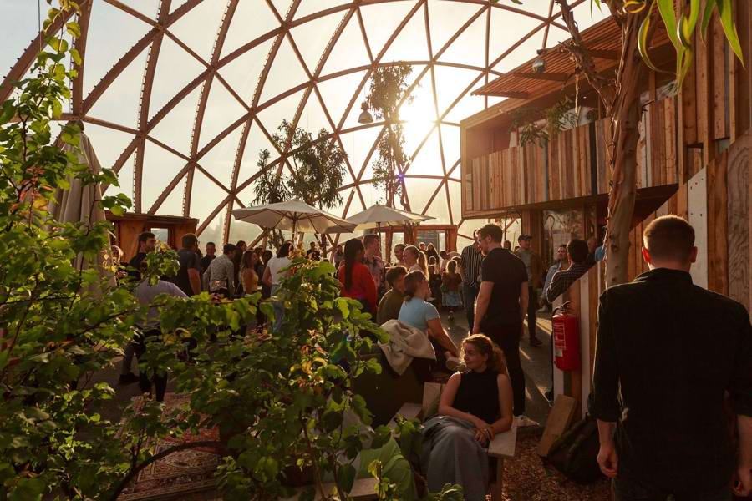
CCC activities
Through a joint learning and sharing approach, the CCC cities develop, test, and promote methods and techniques to involve cultural and creative sectors and industries in the transition from
a linear to a circular economy.
Photo: Aarhus Municipality
Notes:
Specifically, the demo cities will carry out the following activities:
the set-up of a “co-creation arena” which brings together necessary circular economy and CCSI stakeholders for strategic dialogue
the creation of a CCSI-supported business incubation pilot
the creation of a CCSI-supported circular lifestyles pilot initiative
the implementation of local strategies combining CCSI and circular economy
14

Slide 12
1
Co-Creation Arena
A platform for various stakeholders to come together and discuss how to make cities more circular by involving the creative sector.
2
Business Incubation
Drawing on the expertise and skills of creative actors, business support organisations in each city help businesses become more circular.
3
Citizens’ Engagement
With the help of creatives, each city implements initiatives which showcase how citizens can lead a more circular lifestyle.
CCC activities
4
Strategy Development
Each city develops a strategy,
which assigns dedicated roles and responsibilities for creatives in the journey towards a circular economy.
Notes:
Additional information:
In order to implement a circular transition with the support of CCSI, each demo city creates a dedicated and permanent «arena» for dialogue of circular economy and CCSI stakeholders.
CCSI-driven circular transition requires bringing diverse local stakeholders into a regular dialogue so that they share experiences, develop strategic approaches, and start up joint actions.
Municipalities and civil society initiatives (e.g. local NGOs, citizen engagement & place making initiatives), business support organisations, national authorities and regional networks must be addressed to ensure political, institutional, professional, civic and financial engagement.
Circular economy and CCSI practitioners (e.g. business incubators, public & cooperative culture centres & initiatives) must be involved to set circular transition into action.
15

Slide 13
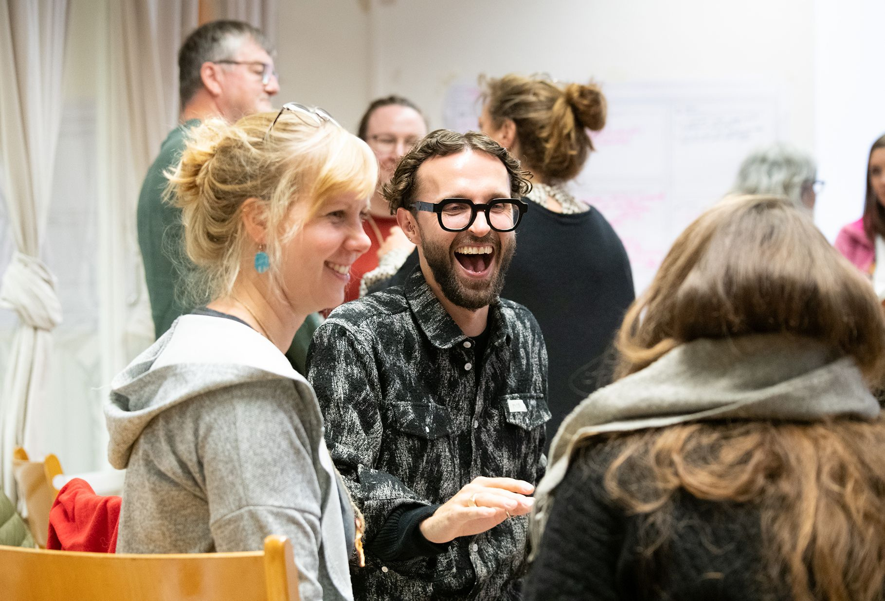
Co-Creation Arena
Photo: Kiel / Jan Konitzki
A platform for various stakeholders to come together and discuss how to make cities more circular by involving the creative sector.
Notes:
Additional information:
In order to implement a circular transition with the support of CCSI, each demo city creates a dedicated and permanent «arena» for dialogue of circular economy and CCSI stakeholders.
CCSI-driven circular transition requires bringing diverse local stakeholders into a regular dialogue so that they share experiences, develop strategic approaches, and start up joint actions.
Municipalities and civil society initiatives (e.g. local NGOs, citizen engagement & place making initiatives), business support organisations, national authorities and regional networks must be addressed to ensure political, institutional, professional, civic and financial engagement.
Circular economy and CCSI practitioners (e.g. business incubators, public & cooperative culture centres & initiatives) must be involved to set circular transition into action.
15

Slide 14
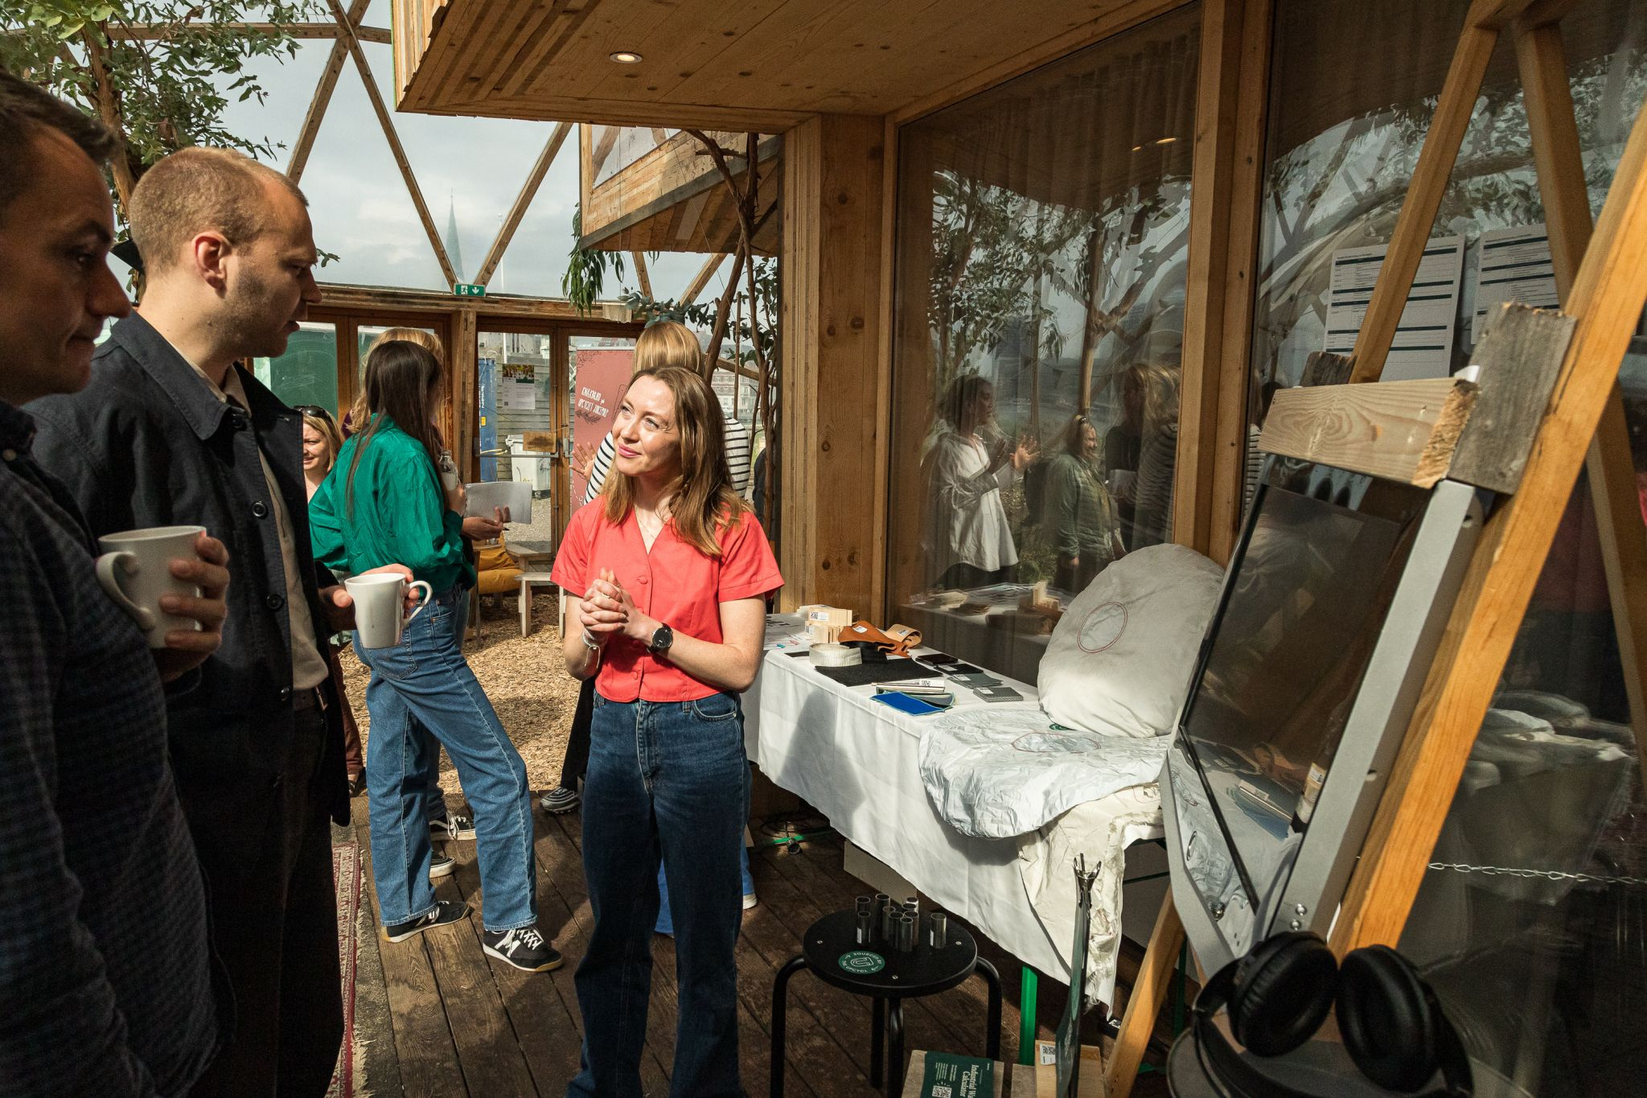
Business Incubation
Photo: Aarhus / DCI
Drawing on the expertise and skills of creative actors, business support organisations in each city help businesses become more circular.
Notes:
Additional information:
In order to implement a circular transition with the support of CCSI, each demo city creates a dedicated and permanent «arena» for dialogue of circular economy and CCSI stakeholders.
CCSI-driven circular transition requires bringing diverse local stakeholders into a regular dialogue so that they share experiences, develop strategic approaches, and start up joint actions.
Municipalities and civil society initiatives (e.g. local NGOs, citizen engagement & place making initiatives), business support organisations, national authorities and regional networks must be addressed to ensure political, institutional, professional, civic and financial engagement.
Circular economy and CCSI practitioners (e.g. business incubators, public & cooperative culture centres & initiatives) must be involved to set circular transition into action.
15

Slide 15
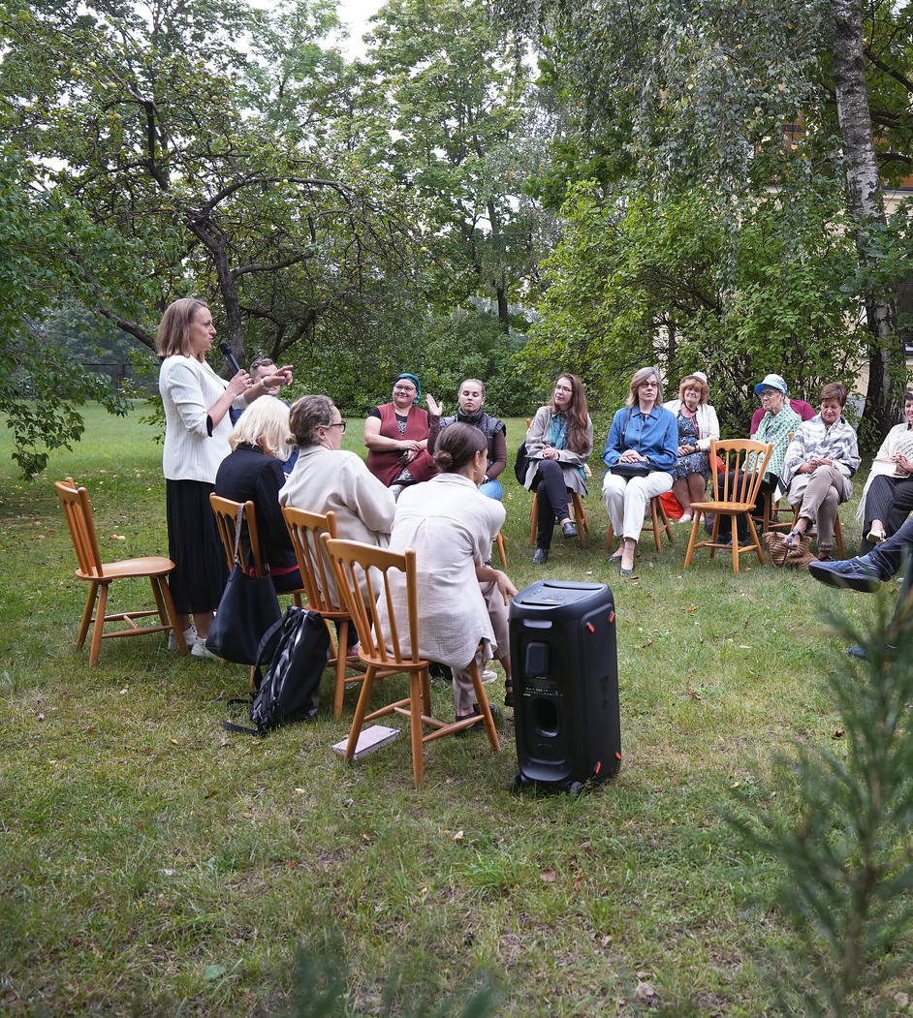
Citizens’ Engagement
Photo: Riga / Riga City Municipality
With the help of creatives, each city implements initiatives which showcase how citizens can lead a more circular lifestyle.
Notes:
Additional information:
In order to implement a circular transition with the support of CCSI, each demo city creates a dedicated and permanent «arena» for dialogue of circular economy and CCSI stakeholders.
CCSI-driven circular transition requires bringing diverse local stakeholders into a regular dialogue so that they share experiences, develop strategic approaches, and start up joint actions.
Municipalities and civil society initiatives (e.g. local NGOs, citizen engagement & place making initiatives), business support organisations, national authorities and regional networks must be addressed to ensure political, institutional, professional, civic and financial engagement.
Circular economy and CCSI practitioners (e.g. business incubators, public & cooperative culture centres & initiatives) must be involved to set circular transition into action.
15

Slide 16
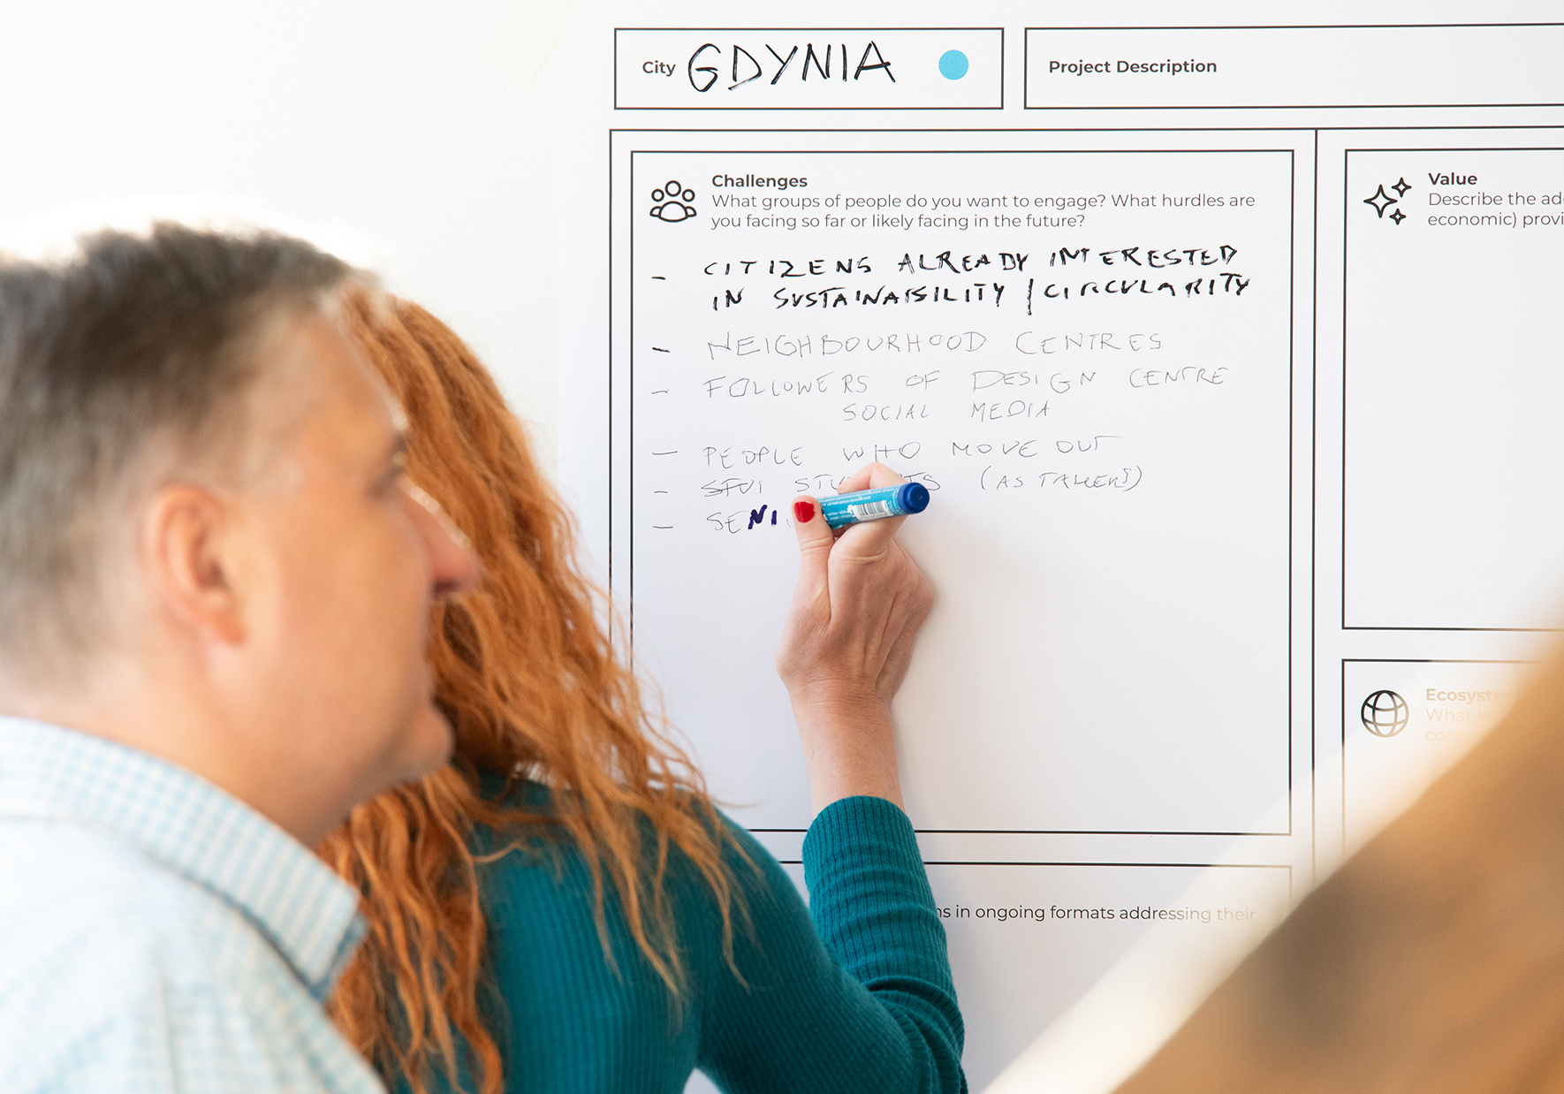
Strategy Development
Photo: Tallin / DCI
Photo: Heinrich-Boell Stiftung
Photo: Riga / Riga City Municipality
Each city develops a strategy, which assigns dedicated roles and responsibilities for creative and cultural actors in the journey towards a circular economy.
Notes:
Additional information:
In order to implement a circular transition with the support of CCSI, each demo city creates a dedicated and permanent «arena» for dialogue of circular economy and CCSI stakeholders.
CCSI-driven circular transition requires bringing diverse local stakeholders into a regular dialogue so that they share experiences, develop strategic approaches, and start up joint actions.
Municipalities and civil society initiatives (e.g. local NGOs, citizen engagement & place making initiatives), business support organisations, national authorities and regional networks must be addressed to ensure political, institutional, professional, civic and financial engagement.
Circular economy and CCSI practitioners (e.g. business incubators, public & cooperative culture centres & initiatives) must be involved to set circular transition into action.
15

Slide 17
Implementation
of CCC activities
Throughout the three year implementation period of the project, the CCC activities are structured in three work packages.
Preparation
Testing
Dissemination
Notes:
The Interreg Creative Circular Cities project brings together 14 project partners from six cities around the Baltic Sea.
The project partners can be categorized into the following types.
9

Slide 18
Outputs and deliverables of the CCC project
Playbooks
Case
Studies
PR Materials
Guidance Papers
Explanatory Movies
Blueprints
Infographics
Notes:
The Interreg Creative Circular Cities project brings together 14 project partners from six cities around the Baltic Sea.
The project partners can be categorized into the following types.
9

Slide 19
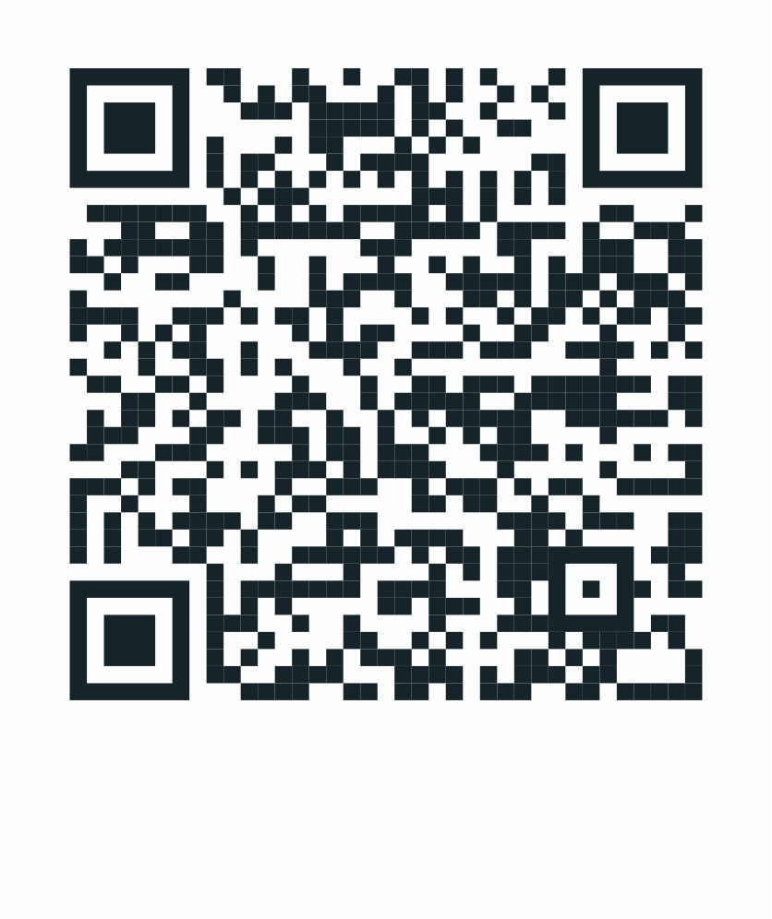
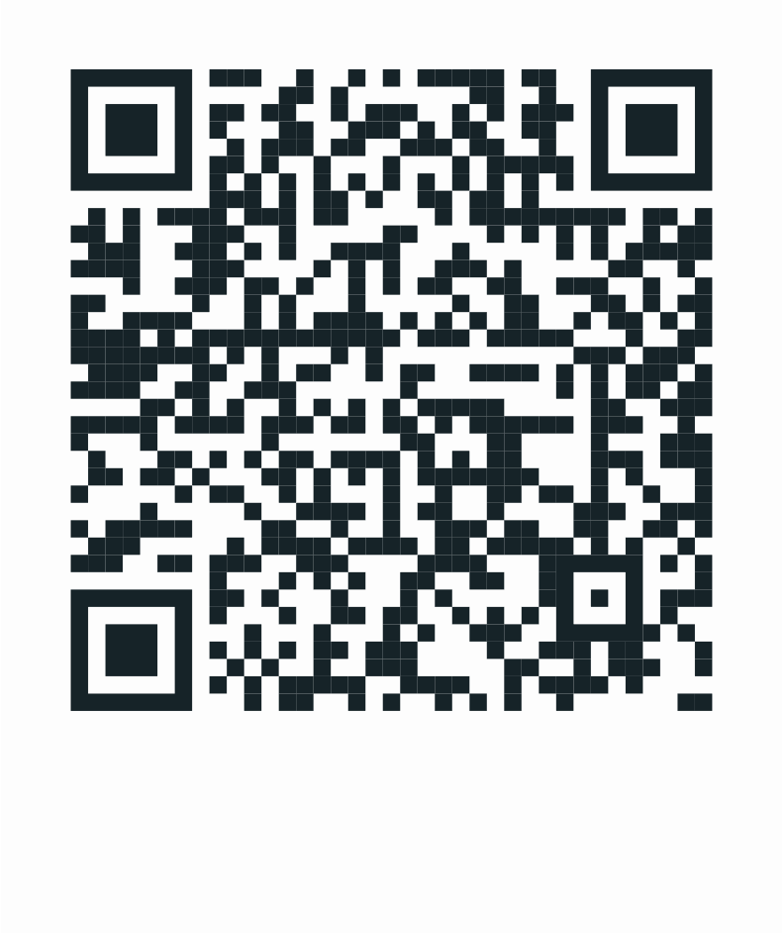
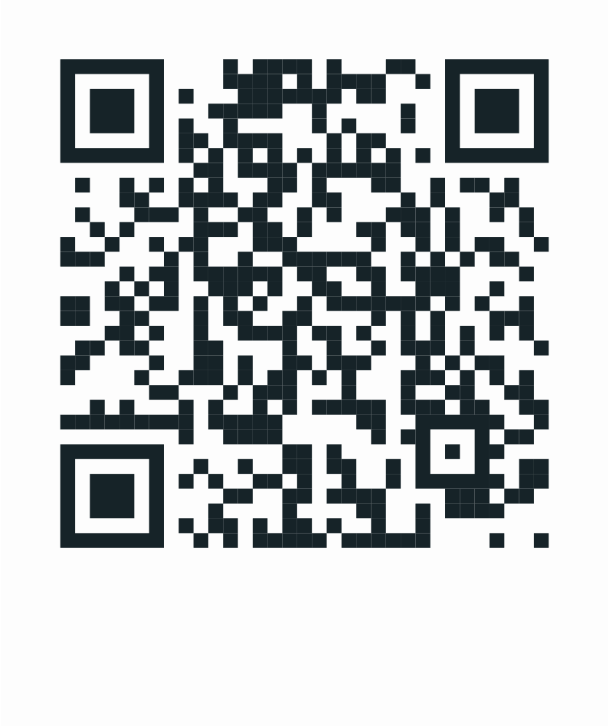

Looking for more information?
Follow us!
Instagram
Linkedin
CCC website
Notes:
21

